Slide 1
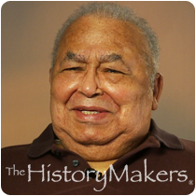
Robert Bragg
Notes:
# Name Robert Bragg # Textbook Knight, Physics for Scientists and Engineers: A Strategic Approach with Modern Physics, 3rd Edition, Chapter 22 # Contributors # Description Robert Bragg was a African American born in Jacksonville , Florida in 1919 . He has made major contributions in the areas of materials characterization using x-ray diffraction and small angle x-ray scattering, and their use as a tool in studying heat-activated processes in materials. He developed methods of quantitative x-ray diffractions of compounds; e.g., Ca(OH)2 in hydrous silicates. Robert Bragg originated the now-standard practice of using the data as self-calibrating in the quantitative determination of preferred orientation in polycrystalline aggregates. His work provides clear guidance in the analysis of the diffraction patterns of materials of high transparency to x-rays, e.g. Be, B, and C. His novel studies of the coarsening of the microstructure of glassy carbon using small angle x-ray scattering have provided the accepted value for the activation energy for a-direction vacancy migration in graphite.His most important work is the recent demonstration that all apparently unordered carbon materials are mixtures of metastable carbon compounds, and his first principles derivation of the equations governing the phase transformations at high temperatures as these materials are converted to graphite. # Sources http://www.math.buffalo.edu/mad/physics/bragg_roberth.html # Photo http://www.thehistorymakers.org/sites/production/files/styles/bio_photo/public/Bragg_Robert_wm.png?itok=tyXqi0F

